Slide 1
Pedagogical Content Knowledge
Helen Chick

Slide 2
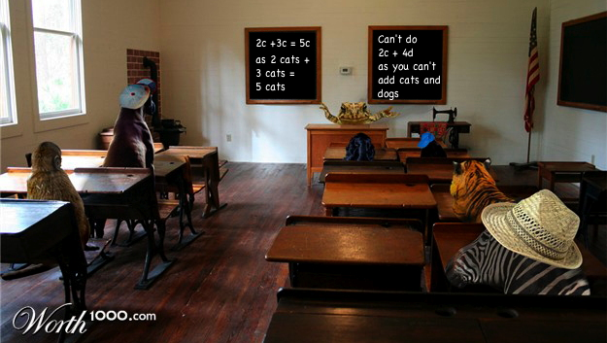
Classrooms

Slide 3
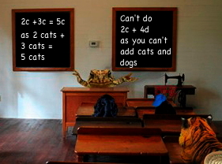
Maths Classrooms

Slide 4
If a frog taught algebra …
Would she know what representations to use?
Would she know what examples to use?
Would she know that “fruit salad” (c=cats, d=dogs) is NOT an effective approach? (and why?)

Slide 5
Consequences of getting it wrong
Enthusiasm will die
Emotionally scarred
Lost opportunities
Fundamental gaps
Financial implications
To cause mathematical termination is devastating ... for everyone.

Slide 6
How do we get it right?
What does it mean to be “maths practice safe”?
What do you need to know to be “maths practice safe”
Do we have “enough days” to prepare our teachers to be “maths practice safe”
What % mark constitutes being “maths practice safe”

Slide 7
Pedagogical Content Knowledge (Hill, Ball, et al.)
Knowledge of Content and Students (KCS): Content knowledge + knowledge of how students think about, know, or learn this particular content. Includes knowledge of typical conceptions and what makes topics hard or easy to learn.
Knowledge of Content and Teaching (KCT): Knowledge of the ways of representing and exemplifying mathematics that make it comprehensible to others.
Knowledge of Curriculum: Knowledge of the programs and resources available for a topic and when to use them.

Slide 8
Pedagogical Content Knowledge (Chick, et al.)
Clearly PCK, e.g,
Knowledge of typical student thinking
Knowledge of cognitive demand
Knowledge of useful representations and examples
Content knowledge in a pedagogical context, e.g,
Profound Understanding of Fundamental Mathematics
Knowledge of mathematical structure and connections
Procedural knowledge
Pedagogical knowledge in a content context, e.g,
Getting and maintaining student focus
Goals for learning

Slide 9
Knowledge Quartet (Rowland, et al.)
Foundation knowledge
Procedures, content, etc
Transformation
Turning content knowledge into pedagogically powerful forms
Connection
Links among topics and lessons
Contingency
Responding to unanticipated events

Slide 10
Role of Mathematical Knowledge
Mathematical knowledge for teaching (Ball, Bass, Thwaites)
Horizon knowledge (where’s it going, where did it come from)
Knowledge of how maths works and is used (applications, maths as a discipline, history)
Connections, connections, connections
Problem solving
Problems of maths teaching as applied mathematics

Slide 11
But what happens if …
A teaching problem arises for which you don’t have the immediate knowledge to address
Rowland et al.’s “contingency”

Slide 12
Teaching maths involves …
Things we have already learned about good teaching (already existing PCK)
Capacity to learn:
Problem solving or application of mathematics to pedagogical situations that we have to develop in the moment for what we don’t know
Based on already existing knowledge
Decide quickly
Reasoned/logically deduced
Maths knowledge big part of what is needed

Slide 13
Mathematics Teaching as Problem Solving
To solve a teaching problem I might draw on
Knowledge that there might be a good representation (even if I don’t know what it is)
Knowing that a student misconception is likely to be because of a “logical” but wrong conception (even if I don’t know what it is)
Knowing that a well-chosen example might illustrate the issue (even if I don’t know what it is)
Knowing the kinds of things I’m looking for might help me find the solutions

