Slide 1
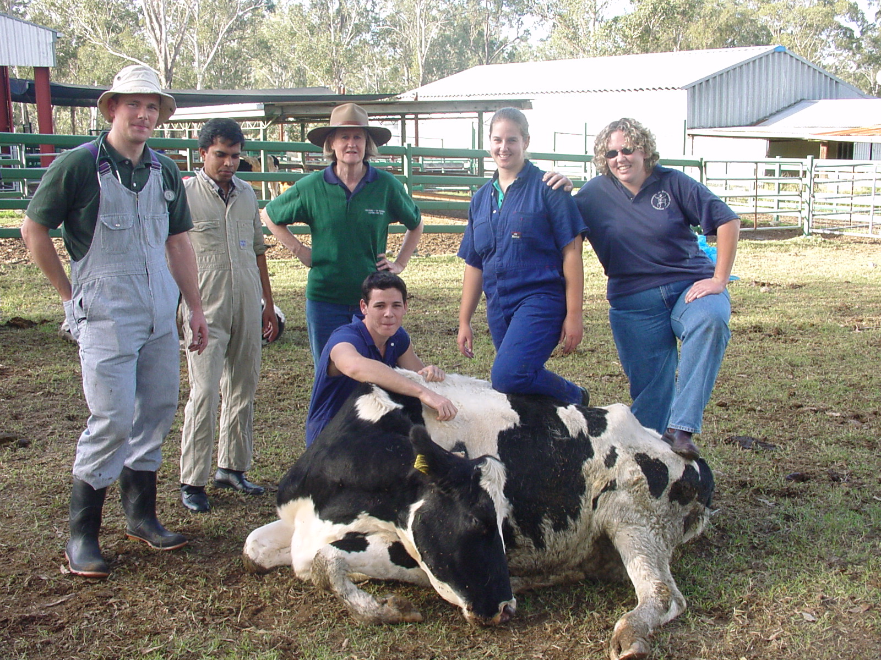
Teaching Veterinary Anaesthesia: Are we there yet?
HELEN KEATES
Lecturer
The University of Queensland,
School of Veterinary Science,
Gatton, QLD 4343, Australia
Notes:
Thanks for the invitation!!
Once a maths teacher
Now I teach Veterinary Anaesthesia

Slide 2
Veterinary Science in Australia…
Programs offered : -
Original 4: -
Students/year
University of Queensland (75 Y plus) 100-120
Sydney University 100-120
Melbourne University 100-120
Murdoch University 80 - 100
Recent programs: -
Students/year 1st graduates
James Cook, Townsville 50 - 75 2010
Charles Sturt, Wagga 30 – 60 2010 (mid year graduation)
Adelaide University. ~40 2013
Notes:
Popular programs
High entry scores required
Low attrition rate
Danger of market flood??

Slide 3
Veterinary Program at UQ
5 year program
3 years pre-clinical
Foundation sciences
Anatomy, physiology, biochemistry, pathology, infectious diseases, reproduction, animal handling etc
2 years clinical
4th yr Lectures, pracs etc
5th yr Clinics (medicine, surgery, anaesthesia, radiology etc), pathology & public health, professional studies
Clinical experiences are grouped in relation to species eg production animals, companion animals, horses

Slide 4
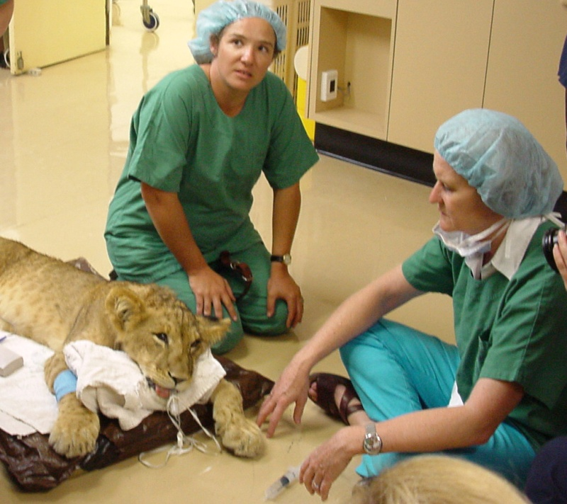
I teach anaesthesia to 4th & 5th year Vet students (for 30 years)
We take our animals to the vet to regain or retain good health. What’s the potential for morbidity (sickness) or mortality as a result of the visit: -
Clinicians may fail to cure
Surgeons may maim
Anaesthetists kill or seriously impair
This is a really important discipline!!!
We must make sure our graduates are ‘practice safe’
To cause an anaesthetic death is devastating!!!! For everyone!
Notes:
I’ve been teaching for 30 years!! Past my ‘use by’ date or just maturing into the job
We all make mistakes, but anaesthetists make deadly mistakes
An early anaesthetic death can result in a student losing confidence and leaving the profession after 5 + years study!

Slide 5
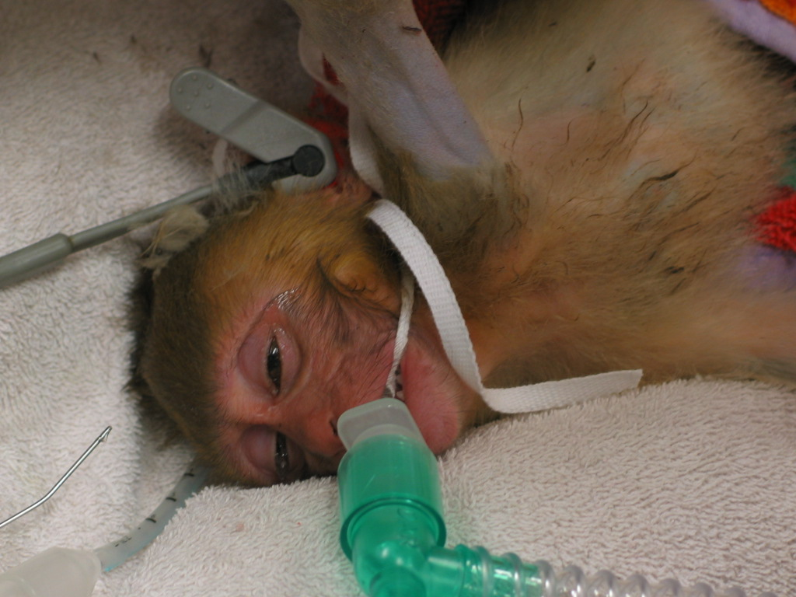
My role in the UQ Vet School
Anaesthesia – the MOST important discipline! (ownership in the extreme!)
Fourth year
15 lectures
Prac classes (14 hours prac /student)
Fifth year
9 h prac/tutorial
5 days supervised clinical cases
In, 2013 fifth years will have 10 days clinical work, no pracs/tutorials
Notes:
Beautiful babies!
Ownership is necessary to do a good job – but can inhibit program development – who gives up precious contact time to allow for new curriculum content

Slide 6
A developing discipline. From this....
Veterinary Counter Practice A treatise on the diseases of animals and the most suitable remedies for them. WRITTEN EXPRESSLY FOR CHEMISTS AND DRUGISTS by qualified and experienced members of the Royal College of Veterinary Surgeons 1930 Edition
“There is an increasing disposition on the part of owners of animals to have them anaesthetised as a preliminary to all serious operations”

Slide 7
“For horses and cattle pure chloroform is to be preferred and is practically free from danger. Dogs and cats are bad subjects for total anaesthesia, and the A.C.E. mixture (alcohol 1 vol, chloroform 2 vols, and ether 3 vols), so much used in human practice, is by some chosen in preference to ether alone, which for dogs is safest, but in the case of cats too exciting. For the latter a mixture of 3 parts of chloroform and 1 part of ether has been found to answer best.”
1 ½ pages on general anaesthesia and local anaesthesia in
horses, cows, cats & dogs

Slide 8
To this....

Slide 9
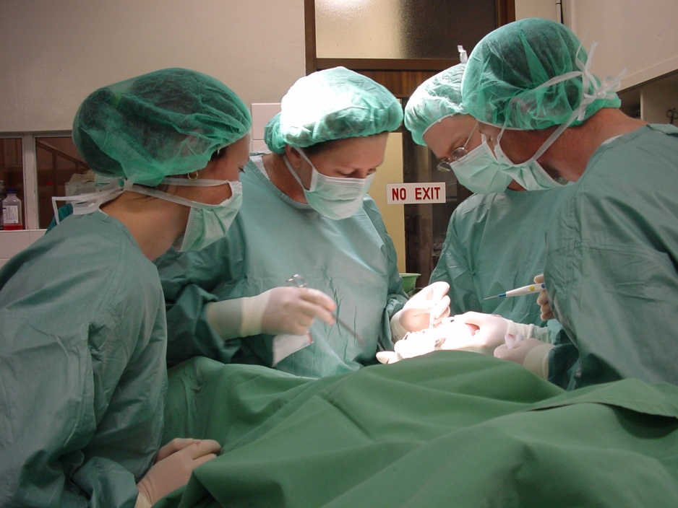
What determines that a new graduate is ‘Practice safe??’
Sound scientific principles
Extensive clinical knowledge
Clinical ‘acumen’
Acumen
the ability to make good judgments and quick decisions
keen insight or shrewdness
Notes:
Sound scientific principles so they can respond to
the professions changing requirements,
public demand for ever improving safety standards
New drugs and techniques as they become available
Extensive clinical knowledge – how much is enough? What do you want your vet to know? What’s acceptable?
50% on an exam??
70%
100%
Clinical acumen??
Define this
Measure it??

Slide 10
How do you define clinical acumen : -
the ability to ‘see’, not just ‘look’
problem solving All clinical work is problem solving
integration of knowledge of physiology, chemistry, physics etc as well as pathology, medicine, surgery
lateral thinking = solving problems through an indirect and creative approach, using reasoning that is not immediately obvious and involving ideas that may not be obtainable by using only traditional step-by-step logic.
How do we measure this???
Notes:
Ability to see
Students will ‘go through the motions’ of examining a patient – few can tell you anything of significance when they’ve finished
Problem solving life in general?
Dog walks through the door : - weight loss, increased urine production, ravenous, NOT with a sign to say ‘I’ve got Type 1 Diabetes mellitus”
Integration of knowledge
Good students, high marks in exams but can’t join the dots
Lateral thinking
some students have the knowledge, but cannot think past what they have been learned from us or from other sources
Can you teach me how to think laterally?

Slide 11
One-45 clinical assessment anaesthesia definitions
KNOWLEDGE: Exhibits core knowledge of basics sciences relating to anaesthesia. Is able to apply this knowledge in an appropriate and logical way. Is able to identify relevant anaesthetic considerations and potential complications.
Is able to formulate an appropriate anaesthesia and analgesia plan.
CLINICAL SKILLS: Is able to appropriately assess a patient prior to anaesthesia. This should include gathering relevant history and diagnostic material as well as performing a pre-anaesthetic clinical examination. Is able to accurately record data pertinent to anaesthesia and patient care i.e. anaesthesia form and treatment chart. Demonstrates good analytical skills particularly pertaining to monitoring the anaesthetised patient i.e. has a thorough understanding of the use and limitations of the anaesthesia monitoring equipment, is able to interpret physiological data and instigate appropriate interventions/treatments when necessary.
Notes:
Explain One-45 – clinical assessment tool
Short on water tight definitions
What’s core knowledge?
Words like: -
Appropriate
Logical
Relevant
Pertinent
Good
etc

Slide 12
TECHNICAL SKILLS: Is able to display suitable animal handling skills and restraint, including showing appropriate compassion. Is able to reliably perform technical tasks e.g. venous catheterisation and tracheal intubation.
INTERPERSONAL SKILLS: Demonstrates effective verbal communication skills with clients and team members. Presents written information in an accurate, logical and organized manner.
Demonstrates compassion.
PROFESSIONALISM: Is reliable, responsible and punctual. Displays motivation and enthusiasm to learn, and perseverance.
Accepts responsibility. Displays initiative in supplementing his/her knowledge and/or skills. Is able to relate to clients, staff and peers. Is honest, trustworthy/exhibits appropriate ethical and professional conduct.
These are very ‘doughy’ criteria for assessment!
Notes:
More rubbery terms

Slide 13
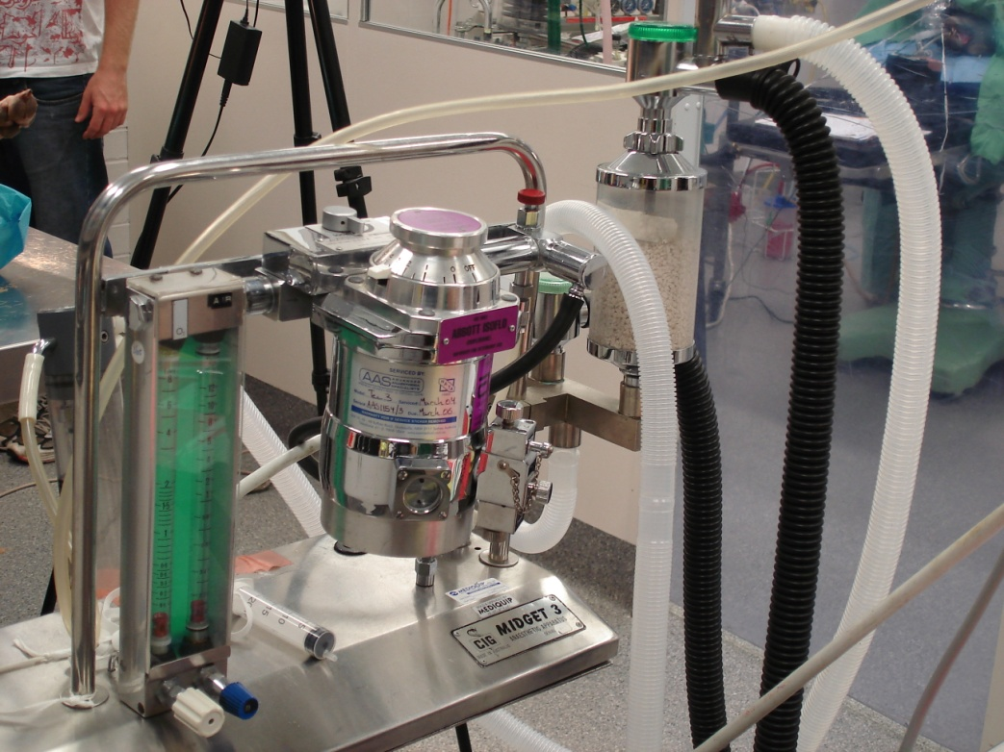
The day the light went on for me about assessment…
End of 2002
Case 1 Sian and the anaesthetic machine: -
Successfully negotiated all assessment requirements to graduate
Ceremony next week
Serious inability to assemble anaesthetic machine!
Basic knowledge/skill
Notes:
Sian
Delightful student
All finished – ready for practice
Fiji
Medically OK, but, in 2003, backward in term of what’s available for vets
Anaesthetic machine to take home
Assembled bits. Last step – connect tubing
Laughed – as unable to do this simple task
Shock horror

Slide 14
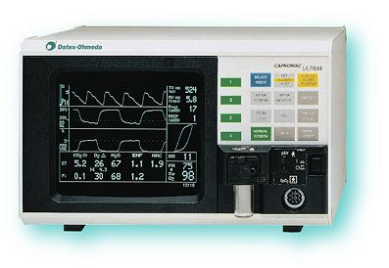
Case 2 Lauren and the capnograph
End of fifth year, all anaesthesia assessment completed successfully
Lauren chose to do the anaesthesia clinical elective – an extension placement for very interested students – NOT remedial training!
Project involving anaesthesia of a large number of pigs.
Could not interpret patients carbon dioxide levels.

Slide 15
Problem…
These students (and others) had jumped through all the required hoops to graduate as practicing veterinarians, but were clearly NOT ‘practice safe’ – we had assessed something else!!
The assessment was lacking!!

Slide 16
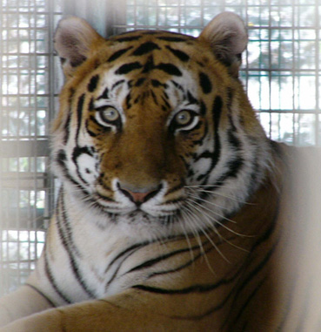
Response…
New assessment task…
The ultimate challenge – an oral exam
Each student
20 – 30 minutes
A variety of questions, most of which involved solving a problem

Slide 17
What’s good about oral exams...
Examiner: -
can explore students strengths & weaknesses (nowhere to hide)
can accommodate students ‘style’ by rewording & clarifying Q’s
can avoid straight recall Q’s
Students take it very seriously – feel exposed and don’t want to appear inadequate

Slide 18
What’s bad about oral exams...
Fear – some students effectively ‘paralysed’
Not all Q’s are of equal complexity
A problem solving exercise for one student may be simple recall for another
Examiner vulnerability
‘I got harder questions’ syndrome
She was mean to me! (have an invigilator!)

Slide 19
Outcomes…
Students loved/hated the experience!!
Many reported enjoying the experience – a mental game – very competitive students
Some ‘crashed and burned’ Tears often appeared to be frustration with themselves for not knowing what they knew they should have
Vivas took on legendary status (Dragon status for me)
Most passed, many did impressively well
Failures had to repeat – offered different examiner
Vastly improved interest in/knowledge of clinical work – astounding improvements observed by clinical staff.
Notes:
Some seriously enjoyed the experience
Mental game – me constructing clinical problems and the student convincing me that they had not just knowledge but the ability to solve clinical problems
Tears – not my primary aim
Down through the earlier years, the students quaked at the mention of my name

Slide 20
Now to the next issue which arose in 2007 (Carrick Assessment project)…
We continued to have a small number of students entering 5th year ill-prepared – some of these have to repeat and may eventually fail to graduate.
How can this be?

Slide 21
What we think is going wrong…
Communication: - students from non-English speaking backgrounds
Cultural: - students may be unwilling to challenge/discuss - too accepting of what is ‘taught’
‘Assessment training’ – assessment tasks and awarding of marks in the earlier years may reward recall rather than processing /application of information
Notes:
Communication: we spend lots of time speaking with small groups of students – sometimes it’s clear that we have lost the students for whom English is a second language
Cultural: The good old ‘aussie’ student rarely suffers from an OD of respect – will challenge us if what we say can be disputed, is contradictory etc. Not so many O/S students. Difficult to initiate discussion, extract opinions.
Assessment training – my fourth year exams – prepared exams, ‘discuss, justify, develop, devise, design etc’ higher order tasks. Many student do badly for the FIRST TIME AT UNI. Are we teaching them that recall is everything?

Slide 22
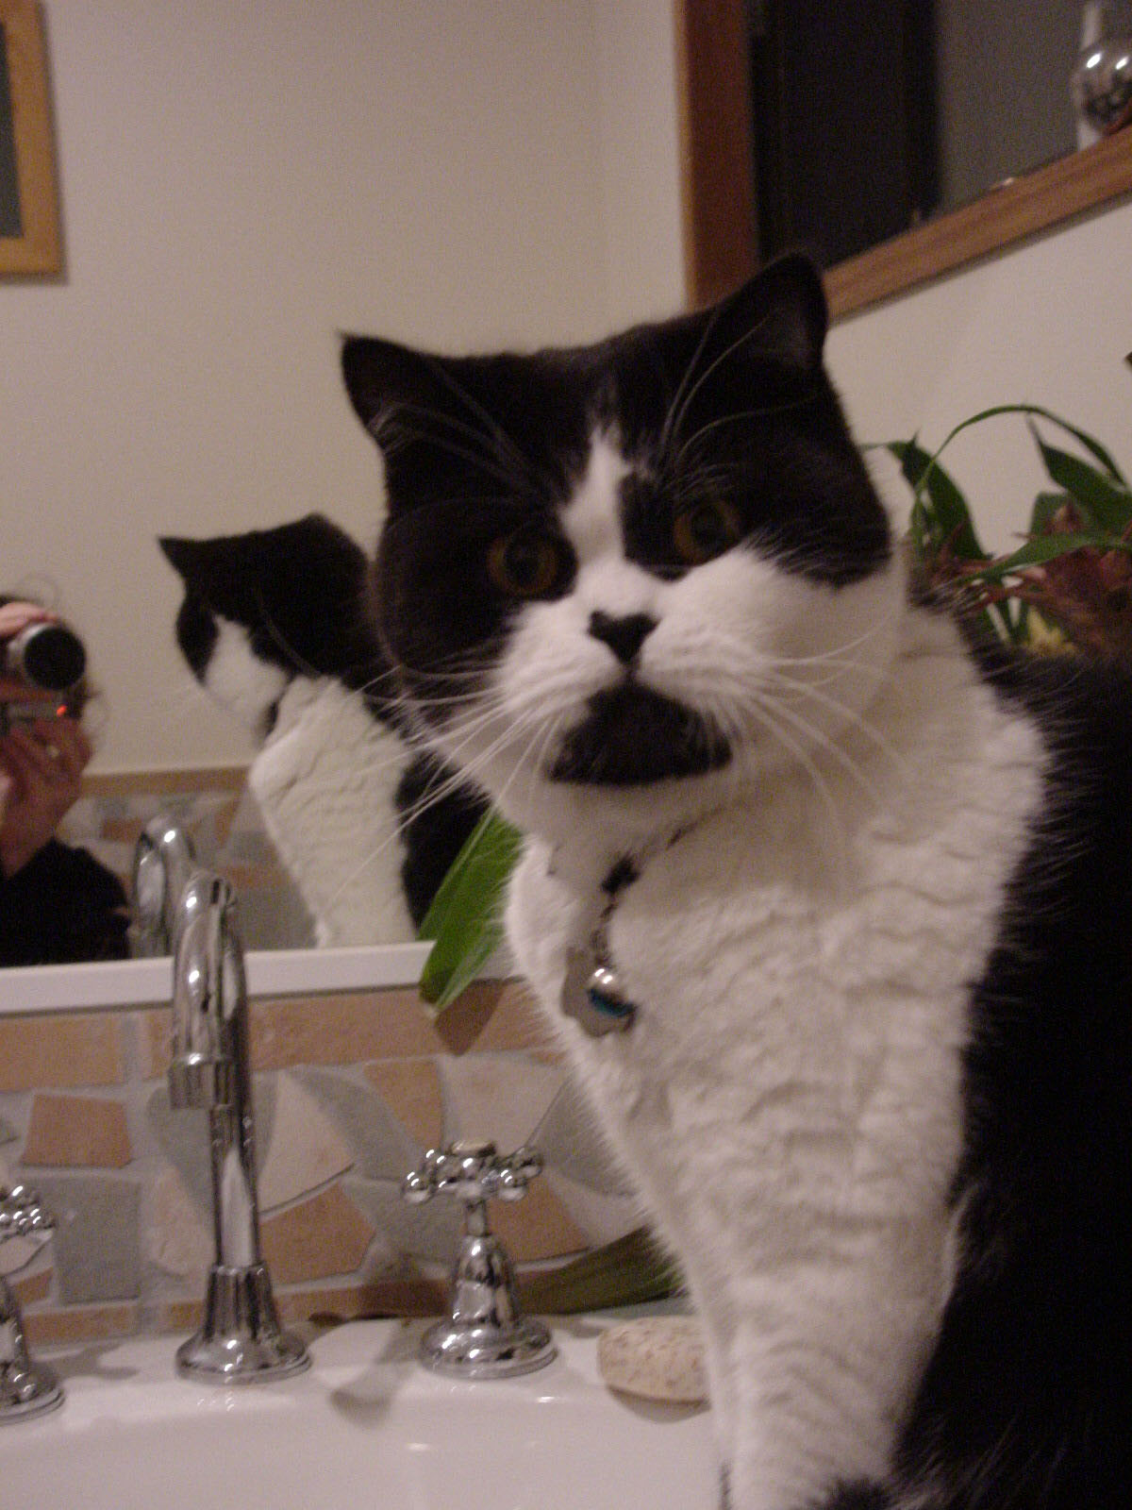
Again, look at the assessment…
To change the outcome, change the assessment!
Design assessment to reward the desired behaviour
Notes:
Self examination!!

Slide 23
New assessment task – oral/practical exam in anaesthesia at the end of 4th year
Rationale: -
1st oral exam - 5th year assessment has a large oral exam component
Student is ‘exposed’ in an oral exam – no exam ‘tricks’
Examiner can explore the students reasoning
Questions ranked according to Bloom’s taxonomy
Topics provided, so targeted preparation
Notes:
The art of disguising uncertainty in written exams – no use in an oral

Slide 24
Aims…
Ensure students carry forward the skills/understanding developed in 4th year
(no learn & flush!!)
Identify those students who may have problems in 5th year & plan remediation

Slide 25
How do we assess the assessment…
Results attained by students
Which Q’s better handled by students
Focus group of students
Perceptions of consultant anaesthetists in 2008
Profession (beyond graduation)

Slide 26
Focus group…
Students prepared all questions provided
‘invaluable experience’ ‘
good preparation for 5th year’
‘affirming and confidence boosting’
‘questions need to be more searching’
‘improved understanding’

Slide 27
Further development…
OSCE’s (Objective Structured Clinical Examinations) introduced in lower years of the program
These are significant hurdles!
Aim to ‘net’ those with problems early enough to redirect their energies and increase the likelihood of success in the program overall

Slide 28
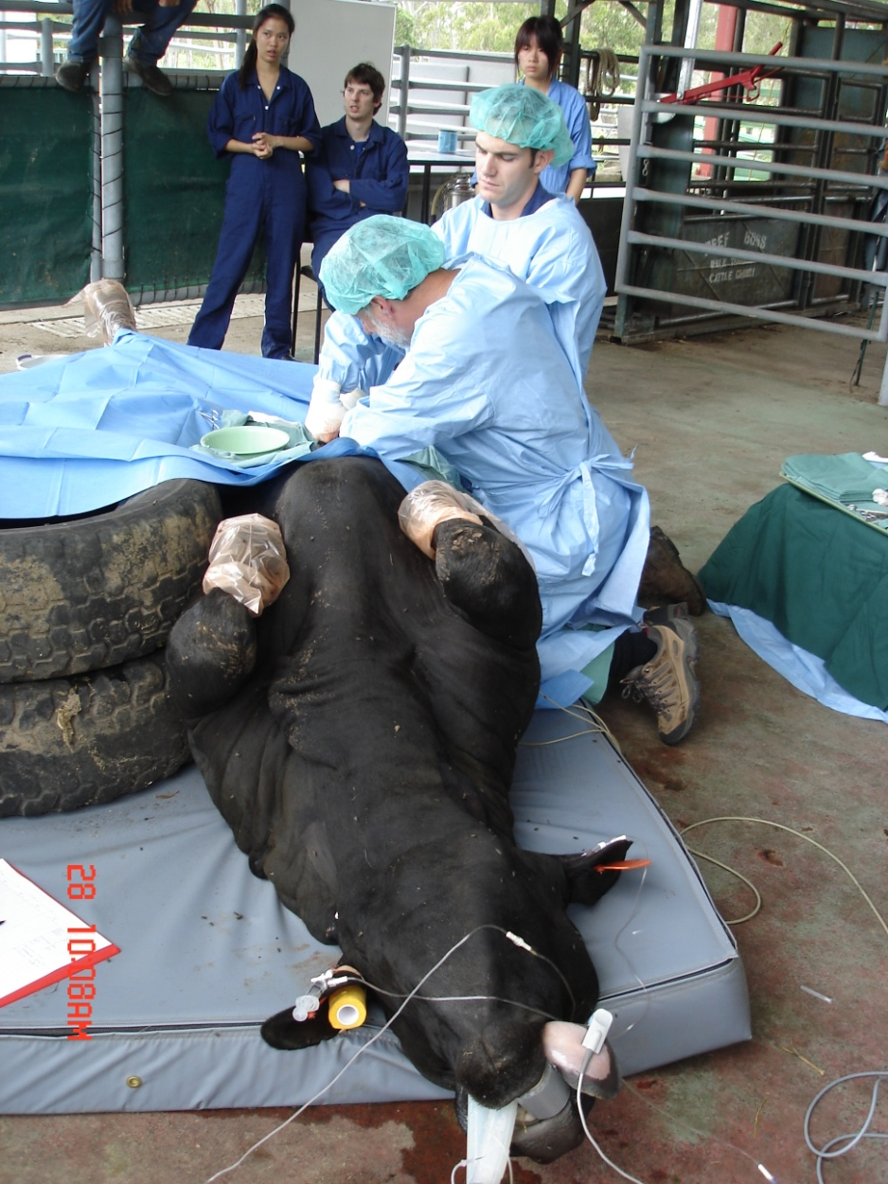
Shouldn’t we have started at the beginning?
Problems not really obvious until the later years
We do seem to be working in reverse!!
Back to selection of students?
Notes:
Can we effectively teach ‘clinical acumen’ ?

Slide 29
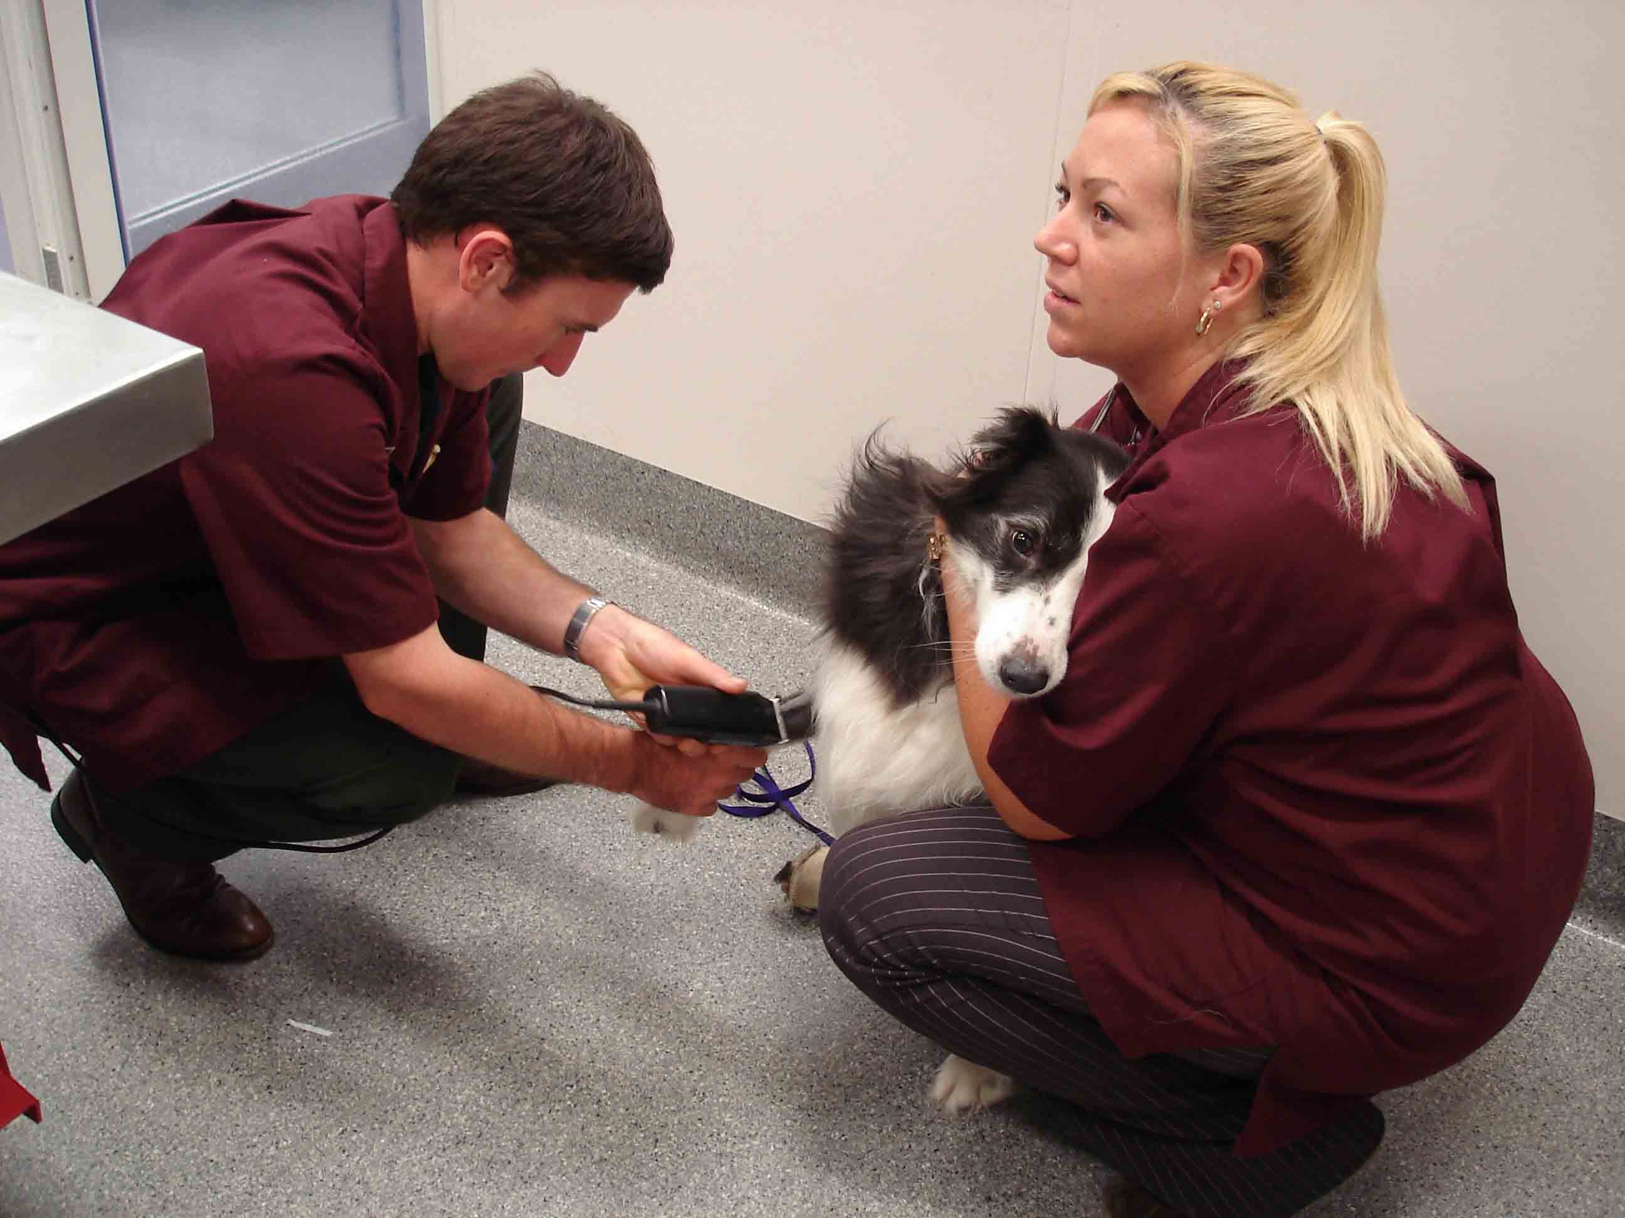
Overall, what are we trying to achieve…
Capture the elusive ‘clinical acumen’
define
create meaningful learning objectives
design learning experiences that empower students to develop clinical acumen
create meaningful measures

Slide 30
In universal children's language…
Are we there yet!
No – and we never will be – for me, that’s what makes teaching so interesting!
All disease states are dynamic – so is program development
Notes:
We discuss, refine, redevelop curricula, learning objectives, assessment tasks each year – still can’t sit back and be satisfied that we’ve got it right!

Slide 31
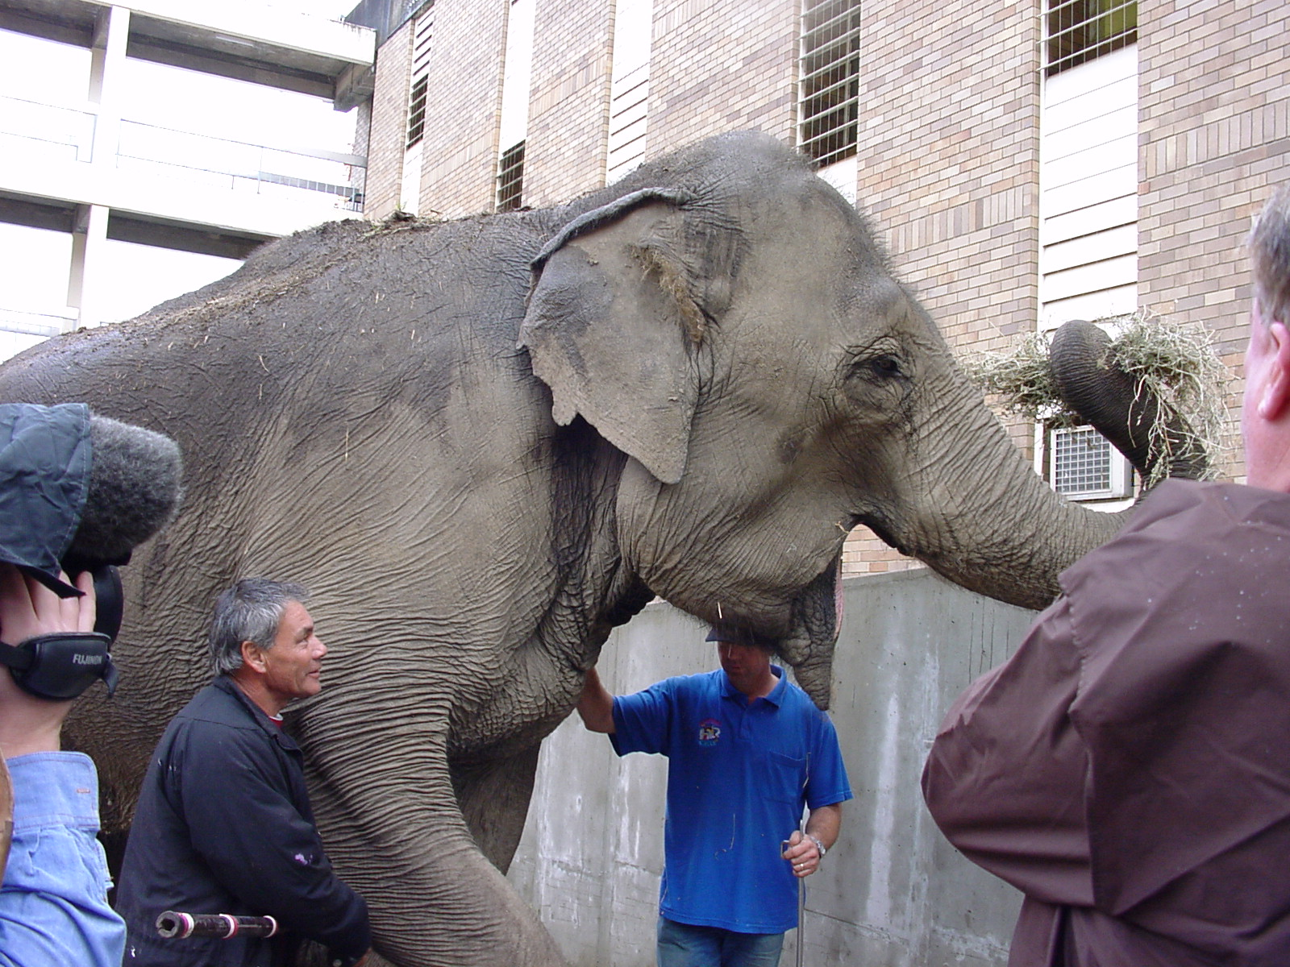

Slide 32
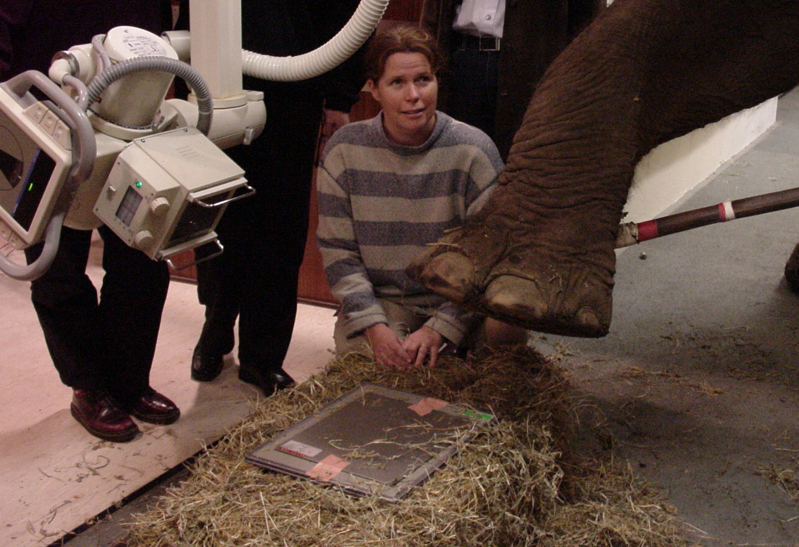

Slide 33
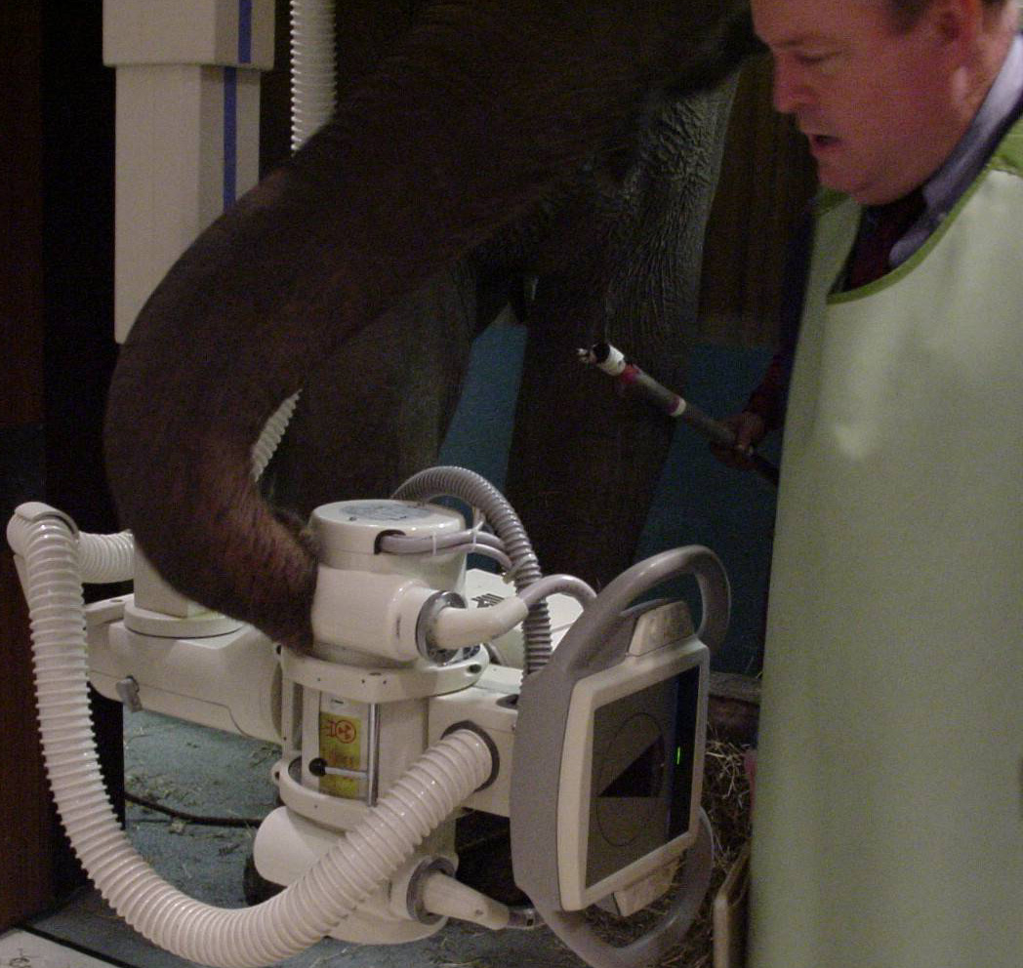

Slide 34
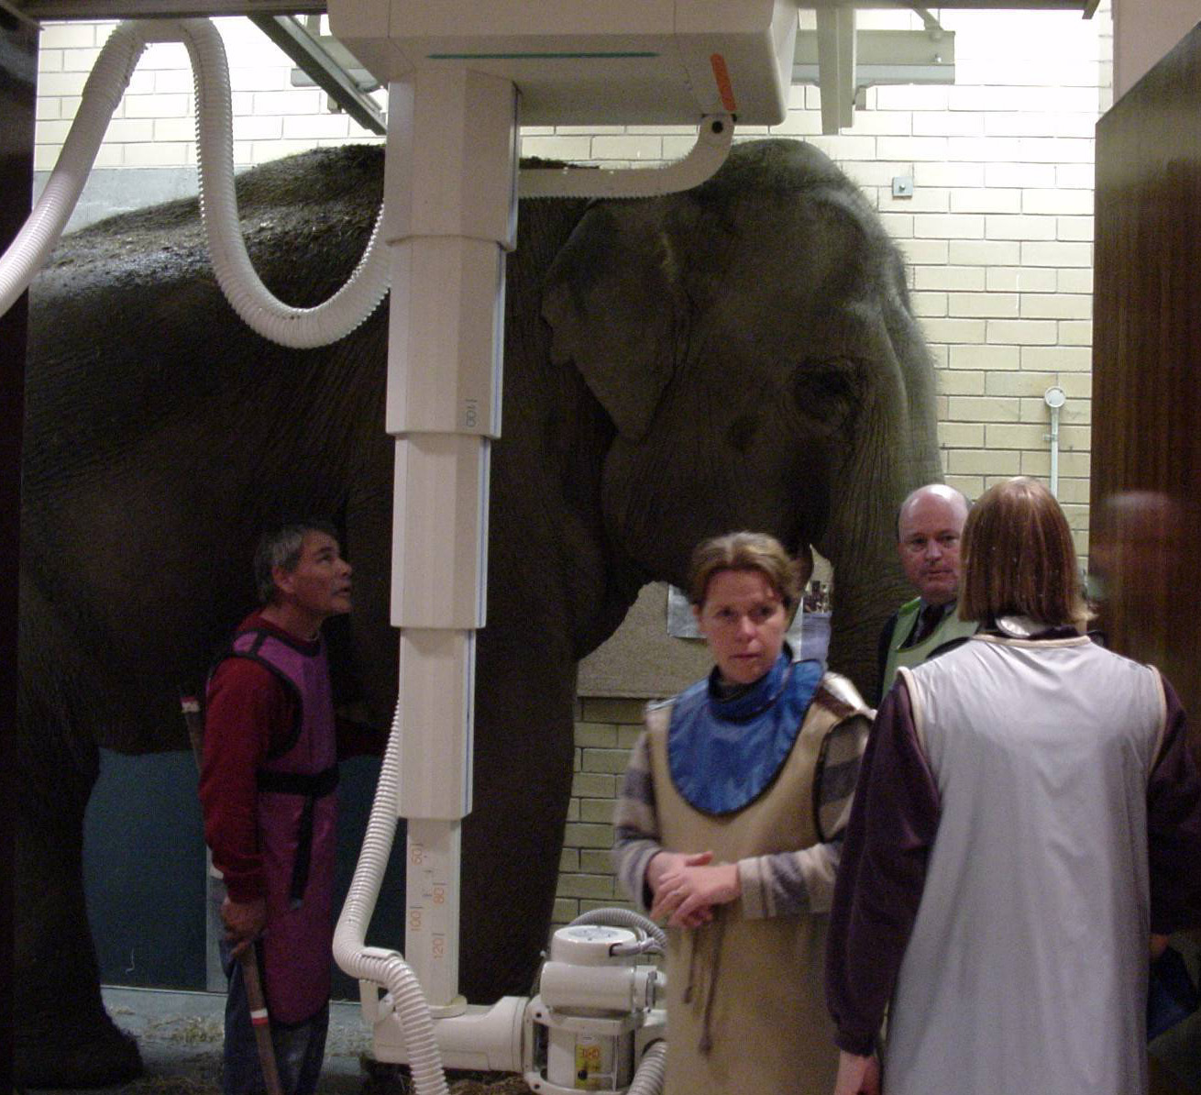

Slide 35
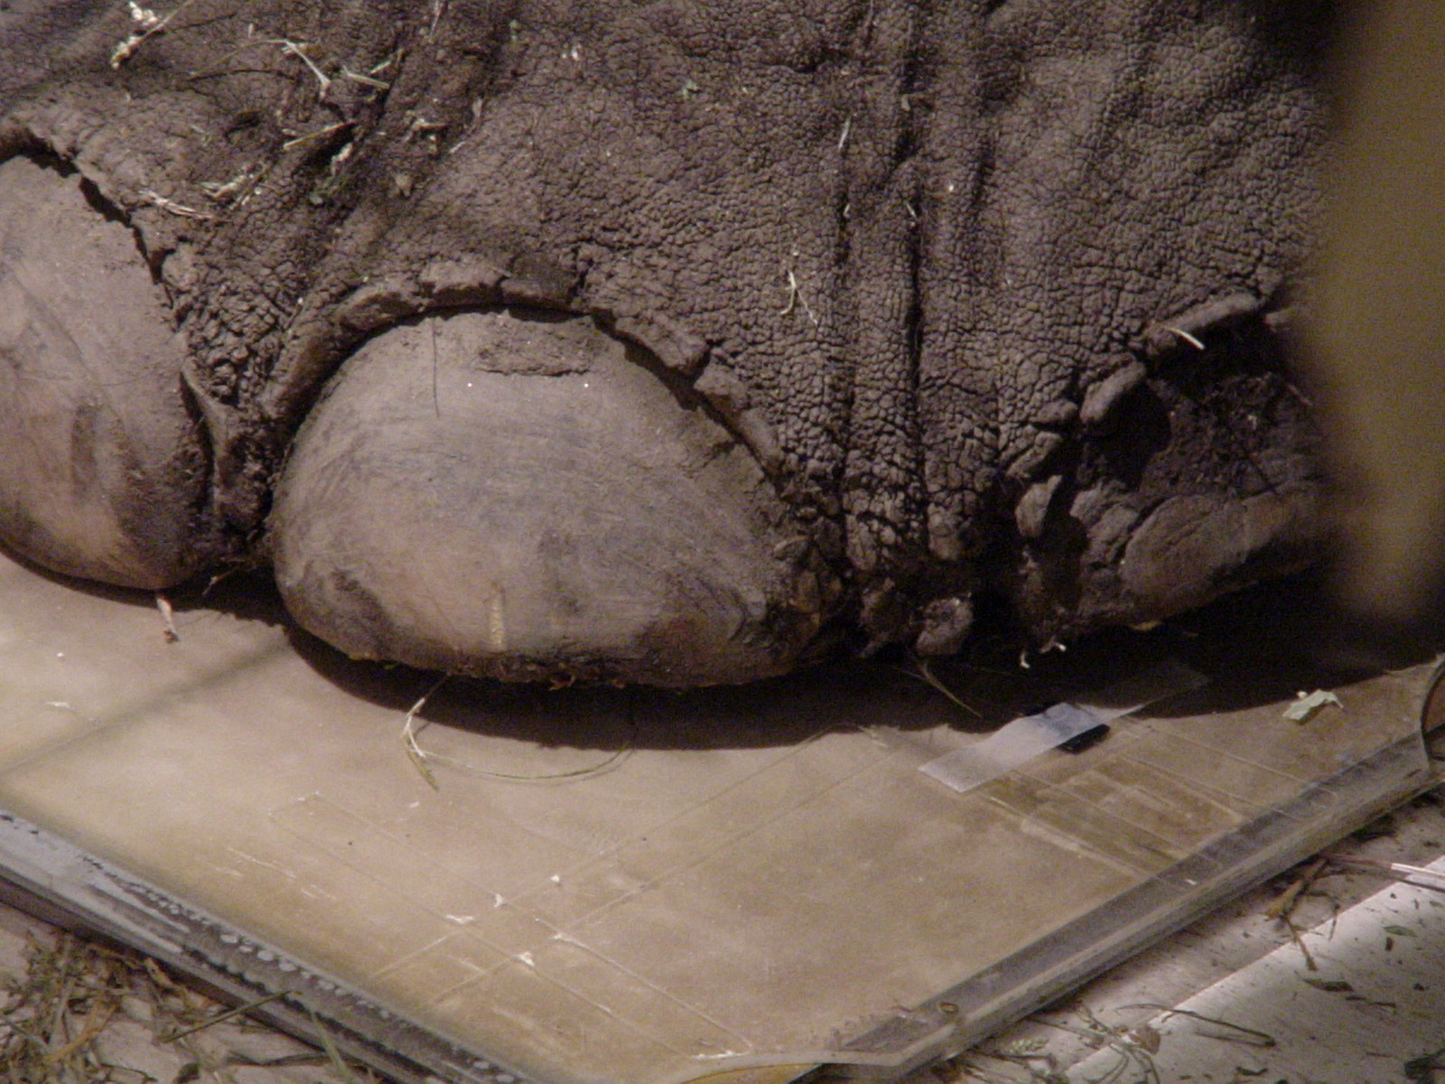

Slide 36
The End

